Slide 1
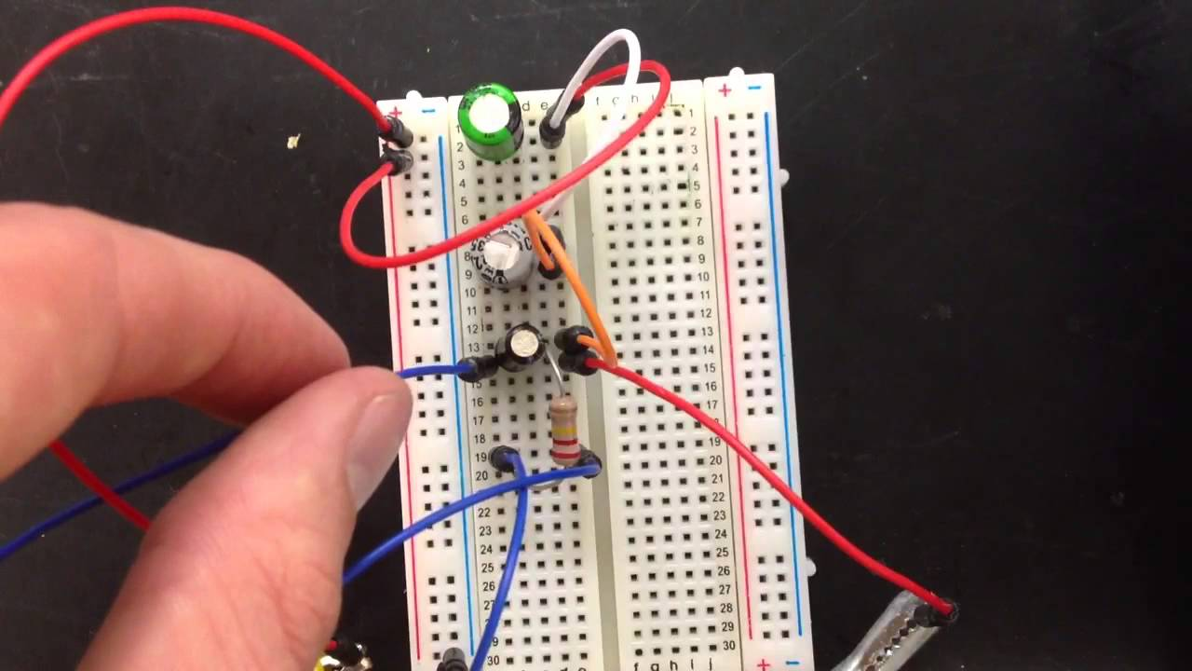
Section 8: Direct-Current Circuits

Slide 2
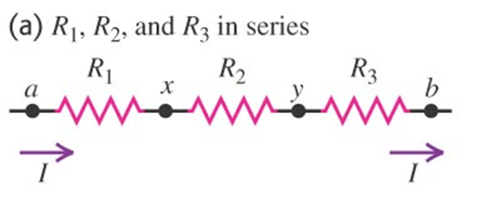

Resistors in Series
Current through each resistor is the same!
$$R_{eq,s}=R_{1}+R_{2}+R_{3}+…$$

Slide 3
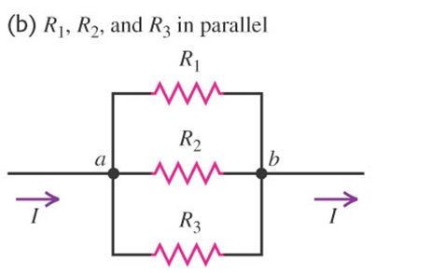

Resistors in Parallel
Voltage across all resistors are the same!
$$\frac{1}{R_{eq,p}}=\frac{1}{R_{1}}+\frac{1}{R_{2}}+\frac{1}{R_{3}}+…$$

Slide 4
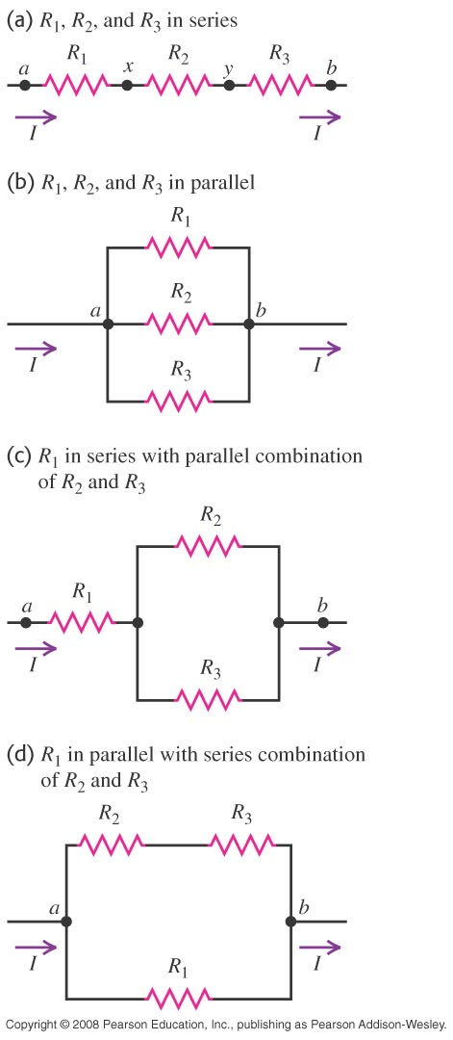
Example: Parallel and Series Resistors

Slide 5
Assign Lab 5 Prelab

Slide 6
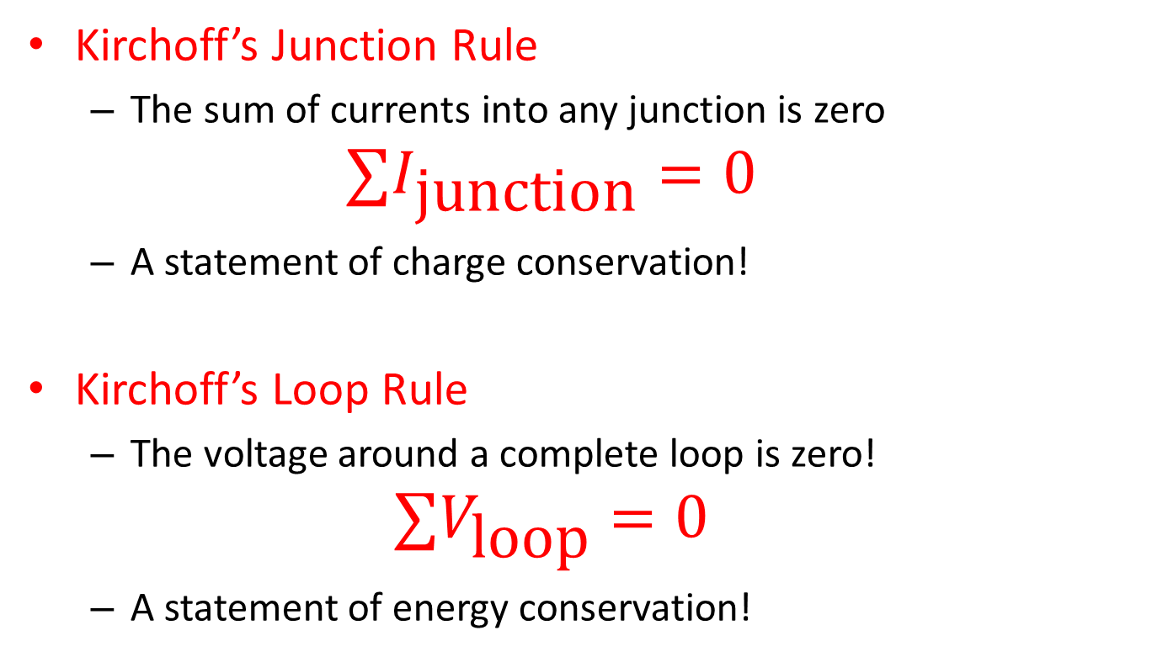
Kirchhoff’s Rules
Kirchoff’s Junction Rule
The sum of currents into any junction is zero
$$∑I_{\text{junction}}=0$$
A statement of charge conservation!
Kirchoff’s Loop Rule
The voltage around a complete loop is zero!
$$∑V_{\text{loop}}=0$$
A statement of energy conservation!

Slide 7
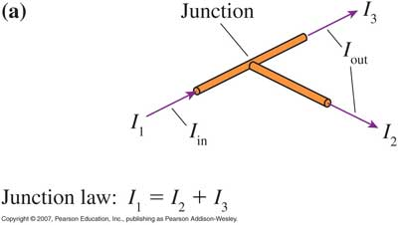
Kirchhoff’s Rules - Junctions

Slide 8
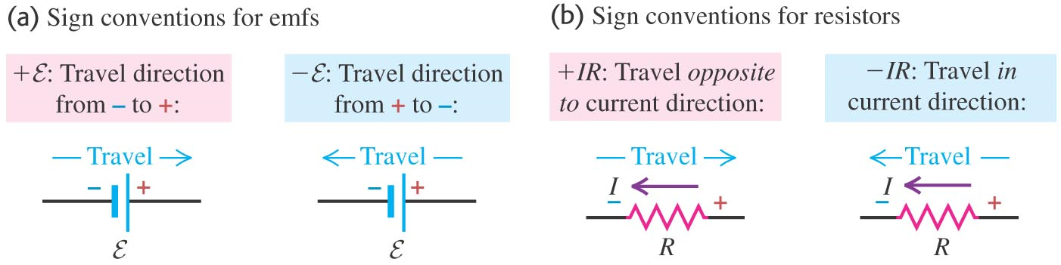
Sign Rules for Voltages

Slide 9
Example: Kirchhoff’s Laws

Slide 10
Activity: Kirchhoff’s Laws

Slide 11
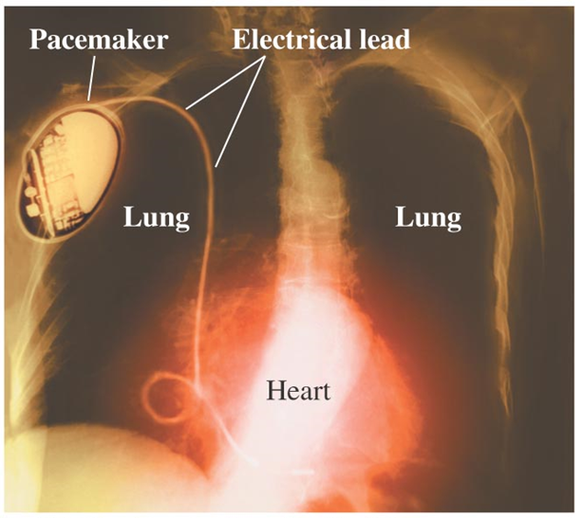
RC Circuits

Slide 12
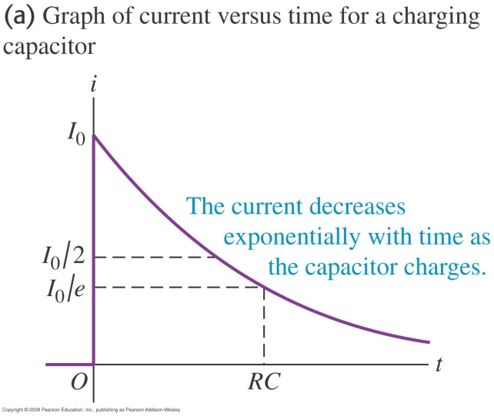
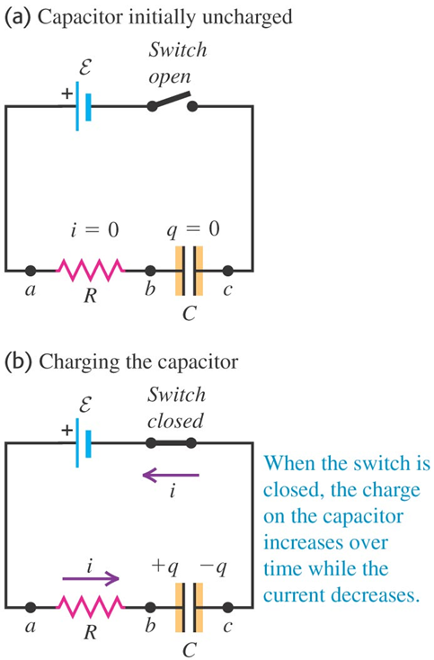
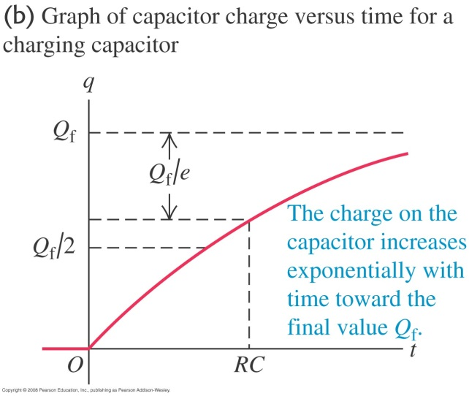
Charging a Capacitor: Qualitative

Slide 13
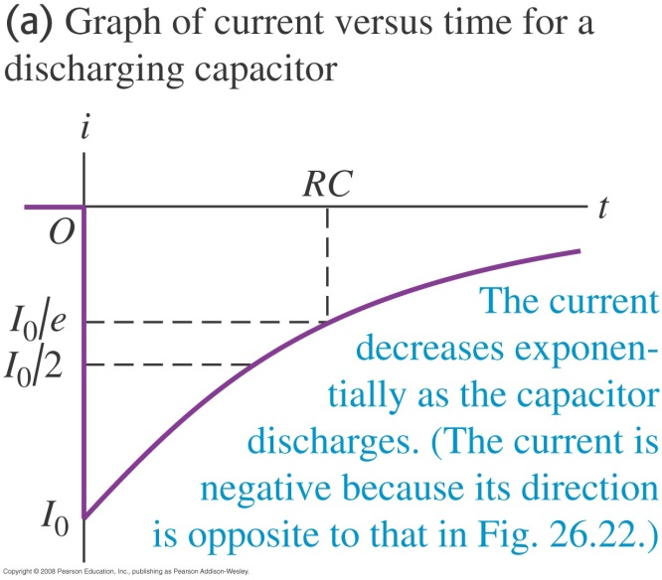
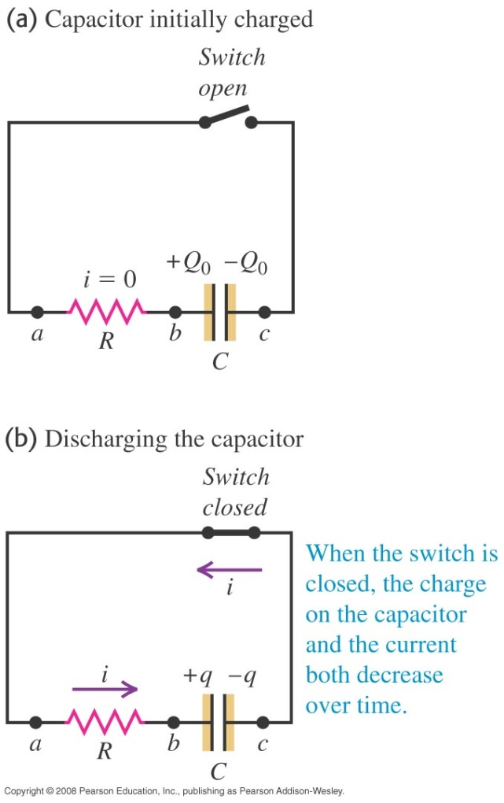
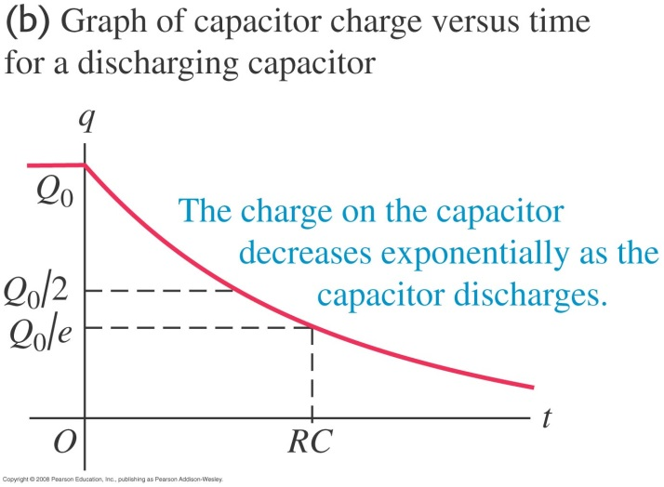
Discharging a Capacitor: Qualitative

Slide 14
Activity: RC Circuits

